Slide 1


Every Day, We Miss the Moment
A customer pays school fees on Monday. By Friday, their child is in hospital. They had no education cover. No medical cover. We had their data — we just never connected the dots.

Slide 2
The Heartbreak We Can Prevent
3-5% insurance penetration,
with 15-20% bank penetration
Manual outreach only
Products offered too late
Cross-sell driven by relationship managers, not data intelligence
Customers unaware of relevant coverage at the moment they need it most
Across African markets, leaving millions unprotected
Every transaction tells a story. A school fee payment reveals a parent protecting their child's future. A hospital bill shows a family facing unexpected crisis. But today's banking systems don't connect these moments to the insurance that could have prevented financial strain.

Slide 3
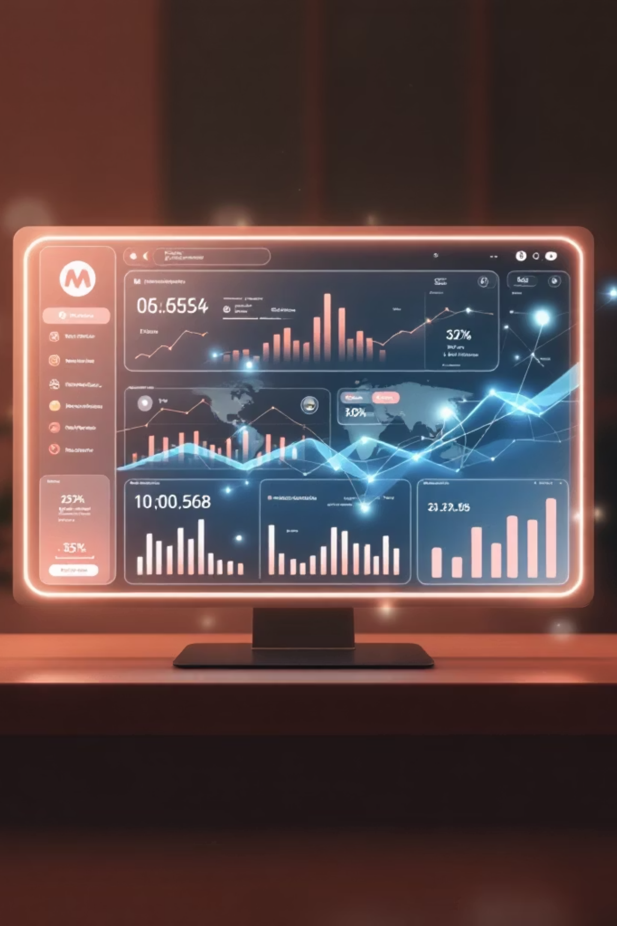
The Answer Was in the Transactions All Along
Banking data already tells us what customers need — we just haven't been listening. Every payment, every purchase, every transfer contains the clues to what protection a customer needs right now.

Slide 4
How Banking Data Maps to Protection
Transaction Detected
Insurance Trigger
School fees payment
🎓 Education Cover
Electronics purchase
📱 Gadget Insurance
Travel booking
✈️ Travel Insurance
Hospital/pharmacy bill
🏥 Medical Cover
Fuel transaction
🚗 Motor Insurance
Real-time transaction monitoring identifies life moments as they happen — then instantly surfaces relevant insurance products before it's too late.

Slide 5

Financial Unity
Protection for All
Bima AI is not just a recommendation engine — it is an expression of Ubuntu: "I am protected because we are connected.
The Vision
When a bank truly knows its customer, it can protect them before they even know they need it. Your transaction data doesn't just tell us what you bought — it tells us who you are, what you're building, and what you stand to lose.

Slide 6

The Moment Is Now
Every day, we have the data. Every day, we miss the moment. Bima AI connects the dots — turning banking transactions into protection, and data into dignity.
Join us in building financial protection for all.

Slide 7





The Ripple of Protection
The Individual
Seen, known, protected through banking data intelligence
The Family
School fees, medical, life cover triggered by real moments
The Community
Small business owners, farmers, informal sector customers reached through banking data
The Institution
NCBA IG, regulators — the ecosystem that enables protection at scale,
The Continent
Pan-African expansion: Uganda, Tanzania, Rwanda, Ghana

Slide 8

Umuntu ngumuntu ngabantu
A person is a person through other people
Now — through data — we protect them all.

Slide 9
The Promise
We didn't build a feature
That is Ubuntu
We built a promise — that no customer should face a loss we could have seen coming
That is Bima AI

